Slide 1


Better Health at Work 2021
Emma Gibson & Iain Miller
Gateshead Public Health

Slide 2
Outline:
Overview of the Better Health at Work Award – Bronze Level Framework
Understanding Role of Health Advocate
Consulting and Engaging with Staff
Developing Health Campaigns
Resources Available
Gathering Evidence for Portfolio

Slide 3
What does health & wellbeing mean to you?
Important to understand the way that different people think about their health and wellness as this influences their everyday behaviour.
Some perceptions are based on what they think they can reasonably expect depending on age, medical conditions and social situation.
What people consider to be healthy differs with each individual – e.g. people may accept smokers cough as the price for the emotional relief
Notes:
people in the workplace have different priorities and different things that are important to them, never static always changing.

Slide 4


Notes:
Recap
Physical – How the body works
Mental – Ability to think clearly & coherently
Emotional – Recognise fear, joy & anger
Social – Make & maintain relationships
Spiritual – Principles that govern our behaviour
Societal – What surrounds us

Slide 5
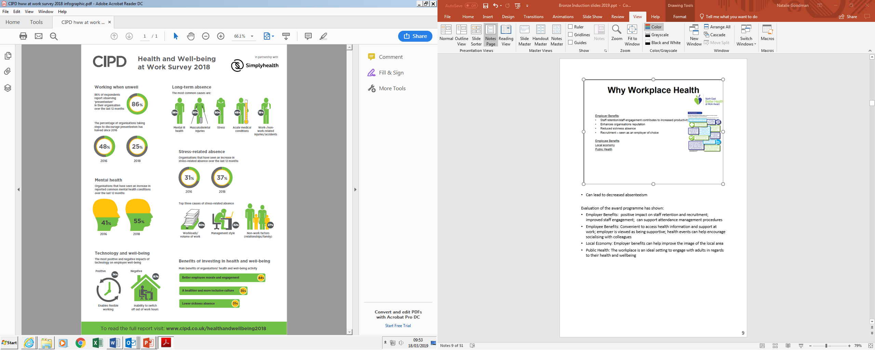
Employer Benefits:
Staff retention/staff engagement contributes to increased productivity
Enhances organisations reputation
Reduced sickness absence
Recruitment – seen as an employer of choice
Employee Benefits
Local economy
Public Health
Notes:
Nat

Slide 6
Overview
Why Workplace Health?

Slide 7
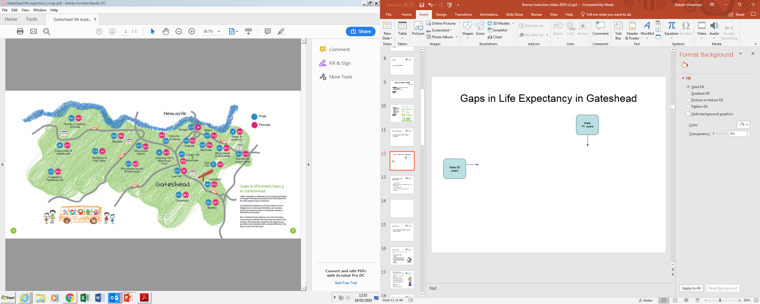
Gaps in Life Expectancy in Gateshead
Notes:
Nat
Life expectancy for men living in Bridges is 9.4 years less than for men living in Whickham South and Sunniside
Look at health profile

Slide 8
North East Better Health
At Work Award
4 > year programme
Bronze, Silver, Gold, Continuing Excellence and Maintaining Excellence levels
New Ambassador status
Helps to embed health and wellbeing within an organisation
Notes:
Stepped programme as it needs to be embedded – employee approach not ‘top down’!!!

Slide 9
Health Advocate
What qualities do they need for the role?
Notes:
Advocates to come up with qualities i.e. Empathy, patience, planning, well organised, non-judgemental, tenacity

Slide 10

Health Advocate Role
Key contact between employer & award co-ordinator
Champion workplace health activities and initiatives
Remove suspicion from workforce
Interest in health and wellbeing agenda
Driving force for award programme
Assist in gathering evidence for portfolio
Help to identify and progress actions
Time
Support from line manager
Route for CPD
Signpost to information and support
Not there to give medical advice
Notes:
Remove the suspicion from workforce – staff may wonder why all the questions/survey
– health advocate to allay suspicions
– the BHAW is for them

Slide 11
Who is Involved?
Line Manager/Senior Team
Support advocate to help fulfil role
Have access to resources
Allow advocate to attend relevant training and updates
Local Award Co-ordinator
Contact
Support
TUC
Notes:
Important to re-iterate at this point that success in the award is linked to support of line/senior management and local award co-ordinator

Slide 12
Induction Overview of
Bronze Level Criteria

Slide 13
Criterion 1: A health needs assessment will be offered to the workforce
Criterion 2: Raise health awareness with the workforce, through a minimum of three health campaigns or events throughout the year, based on the outcome of your health needs assessment. Provide employees with other health information on a regular basis, particularly around the raising of awareness of the major lifestyle risks related to cancer
Notes:
Go though criteria documents - -email out before attendance at bespoke session

Slide 14
Criterion 3: Positive mental health and well-being to be promoted through employee support, training and awareness-raising
Criterion 4: Raise awareness of risky alcohol and drug use within the organisation
Criterion 5: Healthy food choices to be available if there is a canteen, restaurant or vending machine. Otherwise a mechanism is in place to ensure employees are aware of dietary issues and healthy food choices and these are actively promoted.

Slide 15
Criteria 6: How does the company enforce smoke free legislation and develop links to the local stop smoking service for any employees who indicate they wish to stop smoking

Slide 16
Criterion 7: Sickness Absence rates and causes to be collected and monitored
Criterion 8: General awareness of how health can be affected by work activities and assessment of risk.
Criterion 9: Demonstrate the process for ongoing consultation and communication with staff on relevant workplace health issues. Where there is a recognised trade union this should be through an appropriate agreement with them

Slide 17
Criterion 10: The workplace environment should be conducive to health and employee welfare should be addressed – drinking water, washing facilities, clean toilets, eating facilities etc.

Slide 18

Criteria Documents – Examples
Criteria 2 Raise health awareness with the workforce, through three health campaigns or events throughout the year, based on the outcome of your health needs assessment. Provide employees with other health information on a regular basis, particularly around the raising of awareness of the major lifestyle risks related to cancer | How does your organisation comply? Please provide as much evidence as possible in the boxes below. If not applicable or appropriate to your organisation, please explain here.
Describe your organisation’s three main workplace health campaigns or events? List your events and participant numbers in the Campaign Log | Smoking, Alcohol, Stress Awareness - See portfolio section 2 for more information
How have they been promoted to staff? | See portfolio for details
What evidence has been provided to show employee involvement? | See portfolio
How have these campaigns/events been recorded and evaluated using the forms provided or similar? | See portfolio
What other health information has been disseminated to employees during the year and how? | N/A
How have you given staff information/ a general awareness of cancer and the lifestyle risks related to cancer? | Yes, see portfolio
Assessor’s comments

Slide 19

Criteria 2 Raise health awareness with the workforce, through three health campaigns or events throughout the year, based on the outcome of your health needs assessment. Provide employees with other health information on a regular basis, particularly around the raising of awareness of the major lifestyle risks related to cancer | How does your organisation comply? Please provide as much evidence as possible in the boxes below. If not applicable or appropriate to your organisation, please explain here.
Describe your organisation’s three main workplace health campaigns or events? List your events and participant numbers in the Campaign Log | The organisation has carried out three main campaigns (see appendix 1 for participation numbers): Smoking – the organisation was involved with ‘National No Smoking Day’, ‘Stoptober’ and invited Public Health Nurses on site to provide a Stop Smoking Clinic during work time. From this a number of staff have managed to quit smoking (see case study in section 2a). Alcohol – information was provided to all staff about alcohol units and Seasonal Holiday Health. The Public Health Nurses brought interactive alcohol resources and leaflets to a health event in June. Stress Awareness – The organisation has organised two stressbusters sessions for staff to attend. The advocates have visited the resource library to gather a range of leaflets and posters related to stress and also mental wellbeing. Additionally we have had 5 line managers trained in Mental Health First Aid. In addition we have carried out a number of campaigns throughout the year on a variety of topics which were also highlighted in the Health Needs Assessment (see portfolio and also (e & f below)
How have they been promoted to staff? | The events have been promoted in a number of ways including emails bulletins, staff meetings, toolbox talks, plasma screen messages, newsletter, posters and leaflets (see portfolio 2c for evidence)
What evidence has been provided to show employee involvement? | The advocates have taken photographs at all of the events/campaigns throughout the year (see section 2a) and attendance registers were completed at all events.
How have these campaigns/events been recorded and evaluated using the forms provided or similar? | A variety of evaluation techniques have been used to capture opinions and to provide information for future events. These have included ‘graffiti walls’ (2a), ‘H-forms’ (2b), participant feedback forms (2d, e, f) and email/verbal feedback (2g)
What other health information has been disseminated to employees during the year and how? | A variety of information has been provided to staff throughout the year utilising the health and wellbeing notice board and newsletter. Areas covered have included: Be Clear on Cancer (2h), Sport Relief (2i), Movember (2j), Dry January (2k) and Change4Life (see 2l)
How have you given staff information/ a general awareness of cancer and the lifestyle risks related to cancer? | See above for ‘Be Clear on Cancer’ (2h) and ’Movember’(2j) campaign. Additionally information has been provided via cancer awareness leaflets, a Macmillan coffee morning and a toilet door campaign (2k)
Assessor’s comments

Slide 20
Health Campaigns
What Health Campaigns have you heard of?
Notes:
Quick discussion – their thoughts!!!

Slide 21
Examples of Health
Campaigns
Physical Activity
Healthy Eating
Stress awareness
Weight management
Men's Health
Women's Health
Notes:
deliver Healthy4life, Stoptober, change4life etc

Slide 22
Health Campaigns
Advantages
Can reach all the workforce
Raises awareness of an issue
Can gain interest from mass media
Can convey simple messages
Provides a focus for an organisation

Slide 23
Health Campaigns
Issues to consider
Relies on individual behaviour change
Message may not appeal to everyone
Needs to be evaluated
Usually short term – forgotten?
Notes:
Quick discussion – their thoughts!!!

Slide 24
E-Portfolio Building & Assessment Process
Notes:
MT

Slide 25
E-Portfolio Building &
Assessment
Suitable evidence for electronic portfolio
  Policies & procedures
  Minutes/agendas of meetings
  Emails or letters
  Newsletters/e-newsletters
  Photos of campaigns, events, good practice & signage
  Collated results of HNA
  Accident & sickness stats & trends
  Whatever is relevant to your organisation
  CONSULT APPENDICES ON CRITERIA DOCS FOR ADDITIONAL EVIDENCE GUIDANCE
Notes:
MT Inform Health Advocates that they need to ‘explain’ each criteria then link to attachments – overacrhing marking is assessed without portfolio – only youy appointed co-ordinator/assesors see the full portfolio

Slide 26
Assessment Process
Outline of Process
Continuous dialogue with PH lead and review of progress at 6 months.
Pre-assessment (usually 2 weeks before)
Portfolio/assessment document submission
Arrange suitable date
Assessment Visit
Meet with health advocates and other relevant staff
Senior management support
Notes:
MT

Slide 27
Health Advocate Sharing Good Practice Events

Slide 28
Additional Information
BHAW Website
www.betterhealthatworkne.org
Notes:
Mt Load of information on the website – password should be allocated on sign-up from TUC – if not received let co-ordinator/support know asap

Slide 29
BHAWA Website
Lots of virtual support, resources, information and guidance can be found on sub-layer of our website.
www.betterhealthatworkne.org

Slide 30
Induction pack

Slide 31
Better Health at Work Award Gateshead
For further information please contact-
emmagibson@gateshead.gov.uk
Iainmiller@gateshead.gov.uk

Slide 32




Love to Ride - for staff and schools
Love to Ride is a web and app initiative that encourages and rewards cycling for commuting and leisure
Anyone who lives or works in Gateshead join Love to Ride and it is totally FREE
Love to Ride brings riders together with optional mini competitions and exciting prizes
Love to Ride find out what barriers to cycling you are facing and can help you overcome them to help you cycle more

Slide 33



Join Love to Ride and find out more
Visit https://www.lovetoride.net/gateshead and register for free
Want to do more for climate change, healthy active travel or congestion? Email sarahmoralee@gateshead.gov.uk with any questions about travelling to and from work or school for staff and students. The Sustainable Transport team can help with pedestrian and cycle training in school, as well as offering advice and support.
Contact us to find out more about our Be Cool toolkit and Modeshift Stars

