Slide 1
Embedding Outdoor Learning for Social Emotional Wellbeing

Slide 2
“I would like to thank Wilderness Schooling for making me believe in myself again.” Child, aged 8.

Slide 3
Mental Health Outcomes

Slide 4
Attainment Outcomes

Slide 7
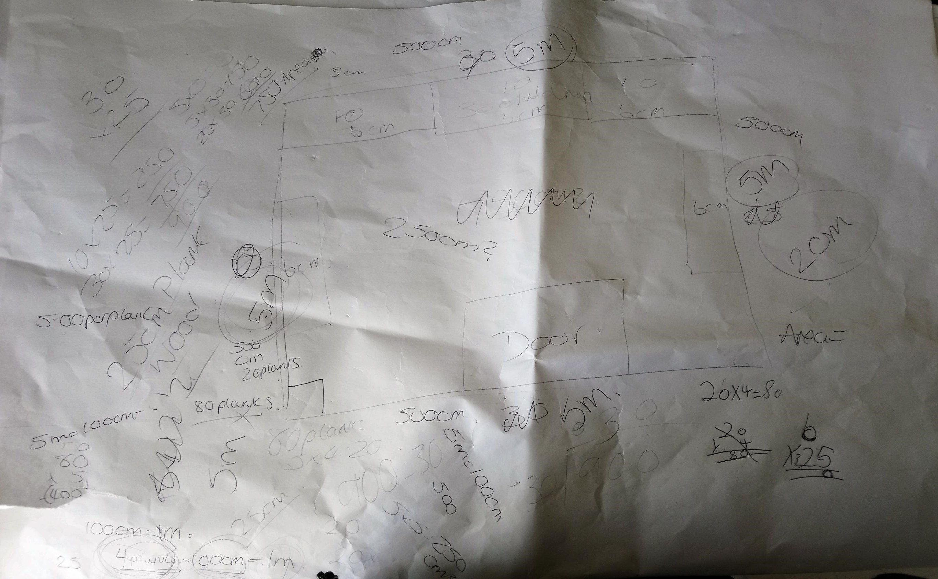

Slide 9
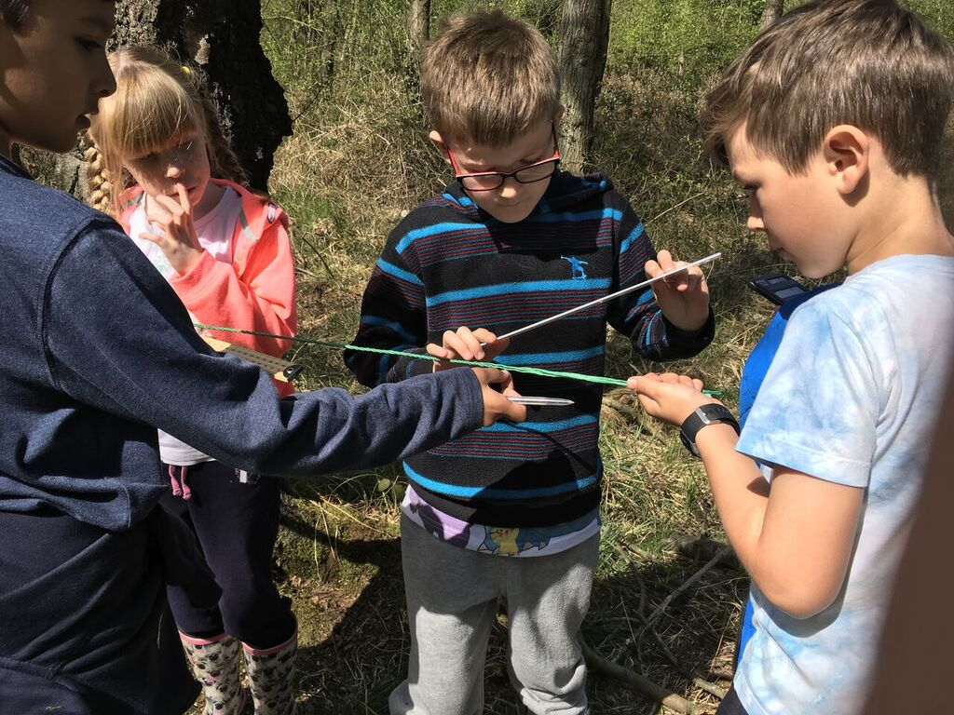

Slide 11
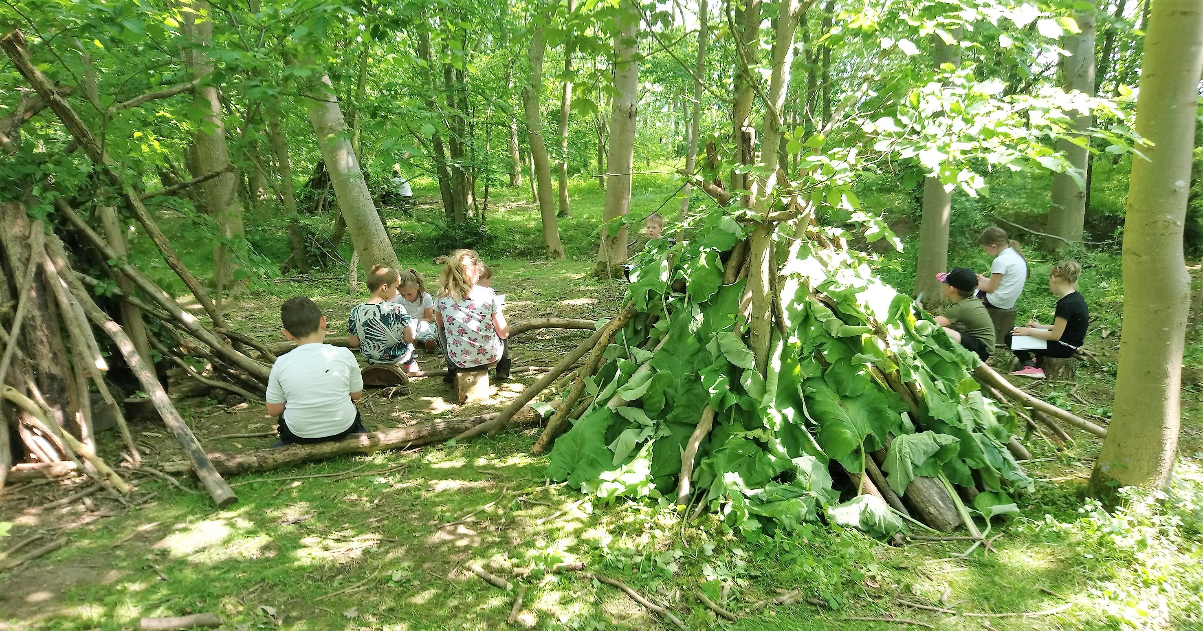

Slide 12
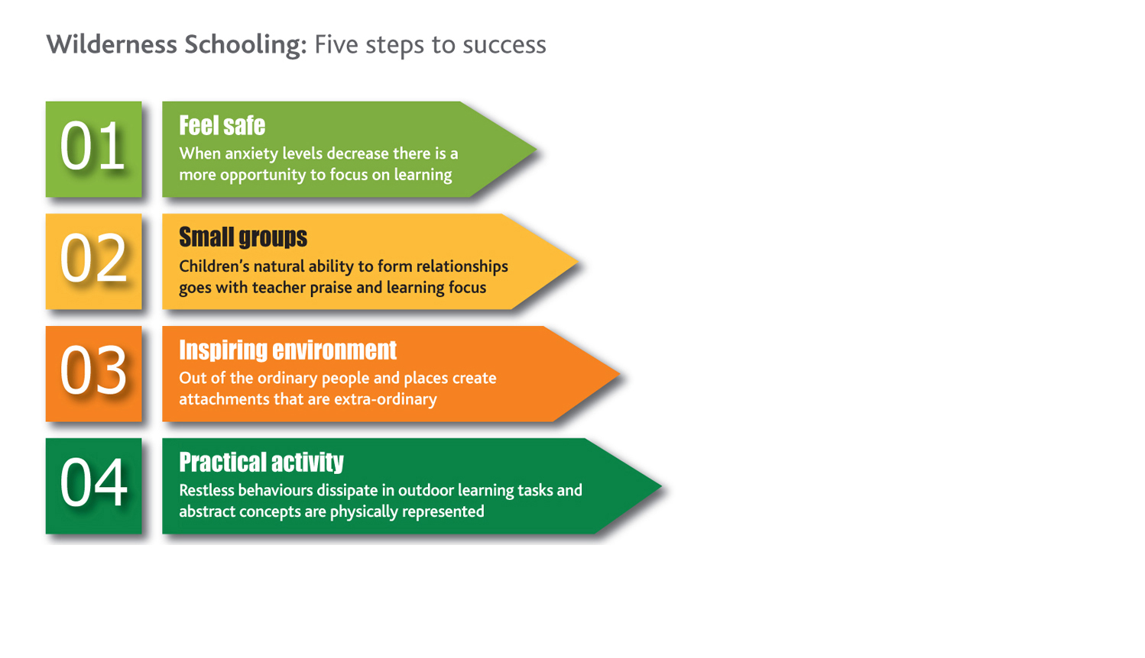

Slide 13
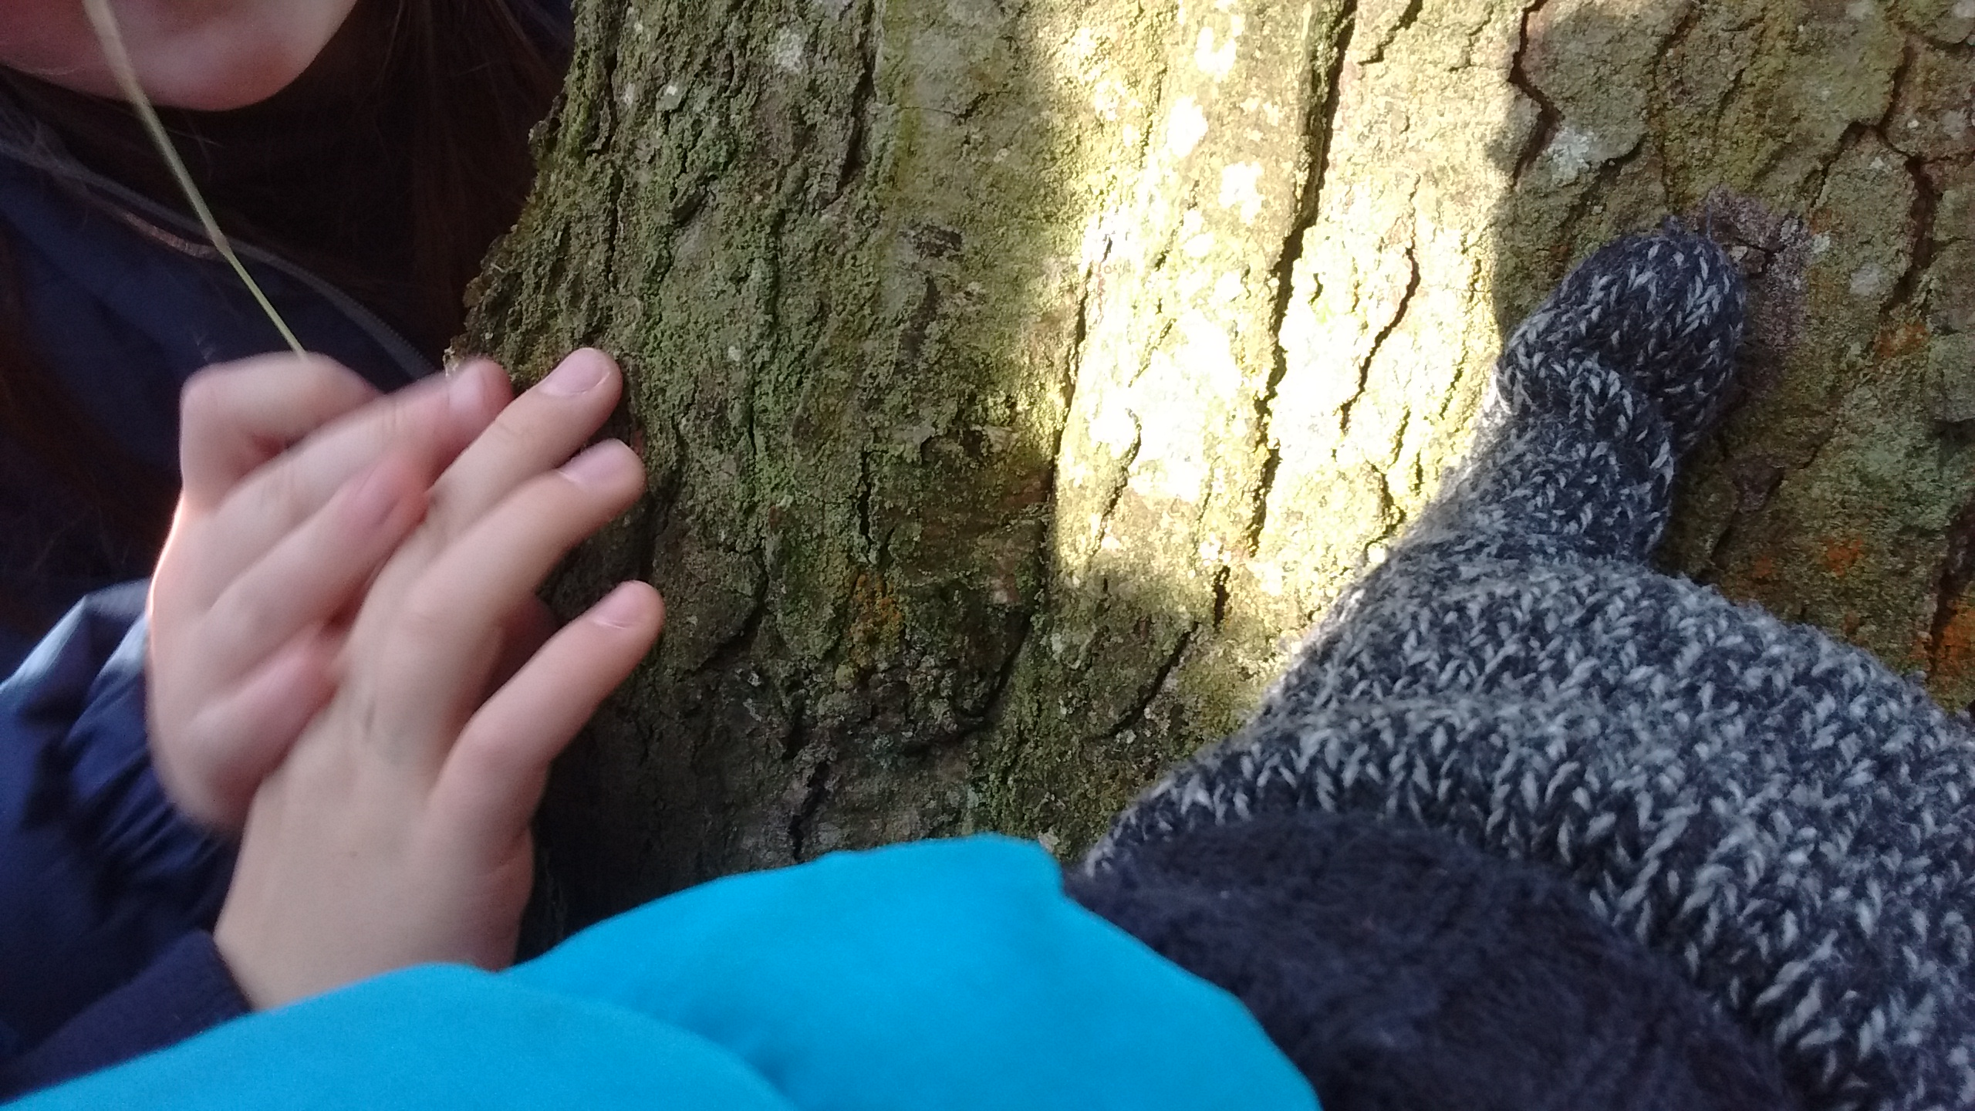

Slide 14
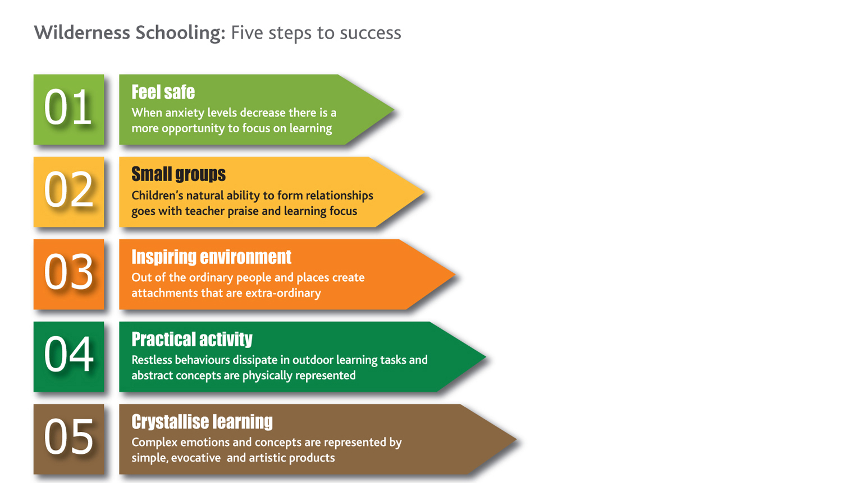

Slide 17
wilderness@northeastwellbeing.co.uk
curiousbeasts@northeastwellbeing.co.uk
Twitter
@WellbeingNorth
@WSbeyond4walls
schools@northeastwellbeing.co.uk
www.northeastwellbeing.co.uk

