Slide 1
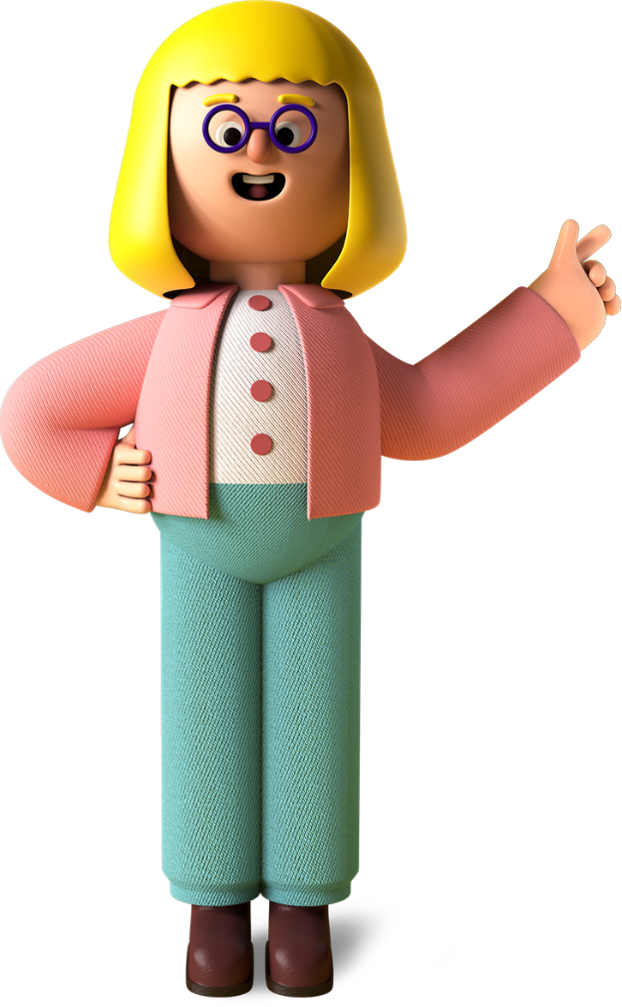
Primary to secondary transition
Challenges & solutions

Slide 2
Aims of this webinar
Identifying your pupils' needs
Potential topics to include in your transition programme
Effectiveness of your transition programme

Slide 3
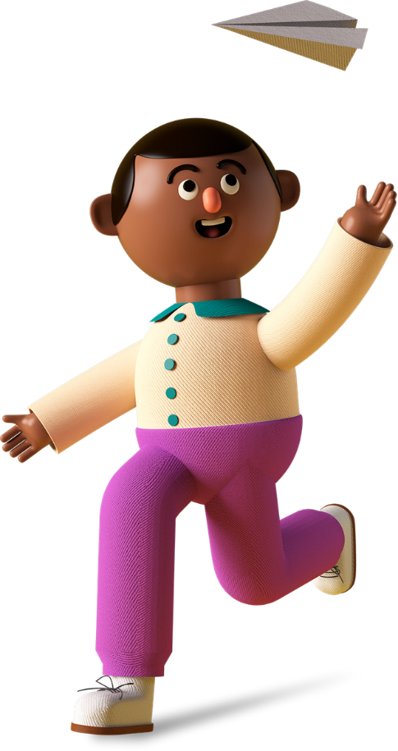
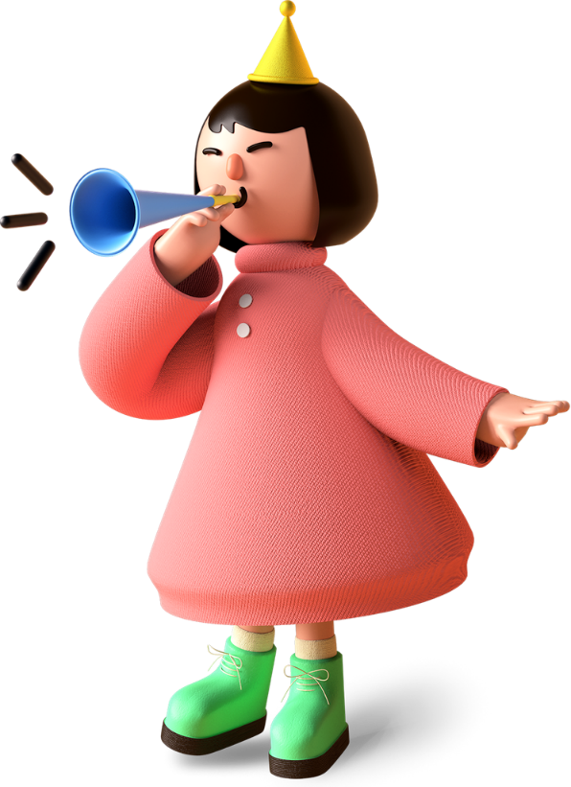
For some children the idea of secondary school is exciting and they can't wait to make the change and take on all the new challenges that secondary school will bring...

Slide 4
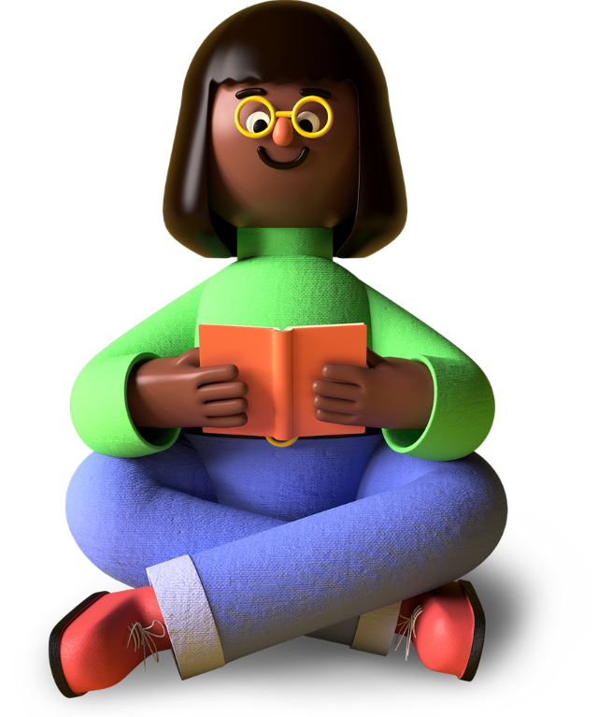
For others it might be much more challenging...

Slide 5
We recently surveyed over 500 year 7 students
38% were stressed or very stressed about moving to secondary school

Slide 6
We also asked about how COVID had affected them
47% feel they have fallen behind with school work
48% felt isolated
47% felt more anxious or depressed

Slide 7
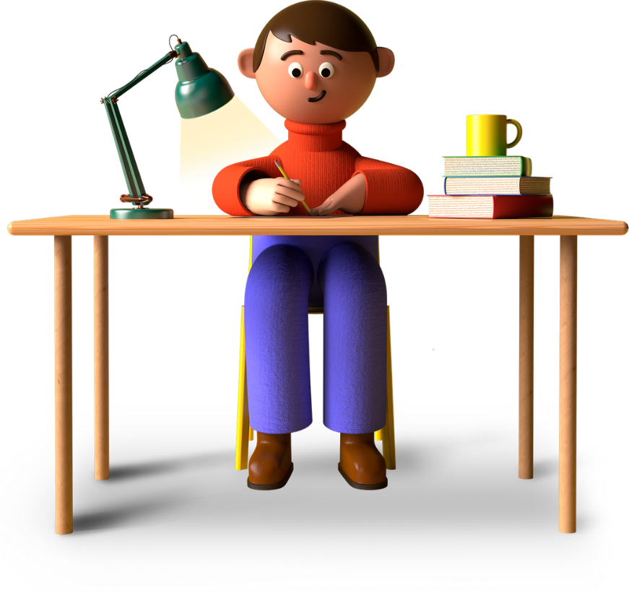
62% felt upset about not seeing family and friends
53% felt more angry or frustrated
48% had difficulty managing emotions and moods
49% worry more about the environment

Slide 8
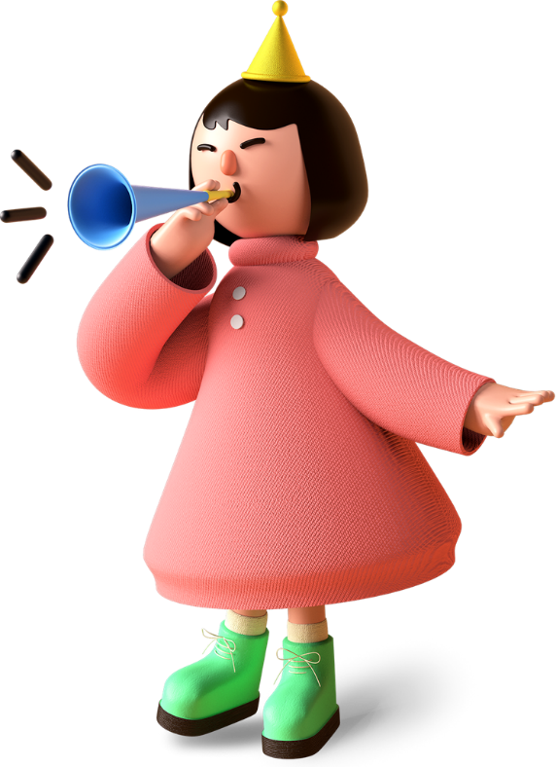
"I wish we could have had more bonding activities in Year 7 to meet new people."
"I wish my secondary school had explained what you could do if you get bullied."
"I had to self-isolate and was two weeks late starting. This made me sad and stressed."

Slide 9
What are your pupils worried or anxious about?
Do you think they're ready for secondary school?

Slide 10
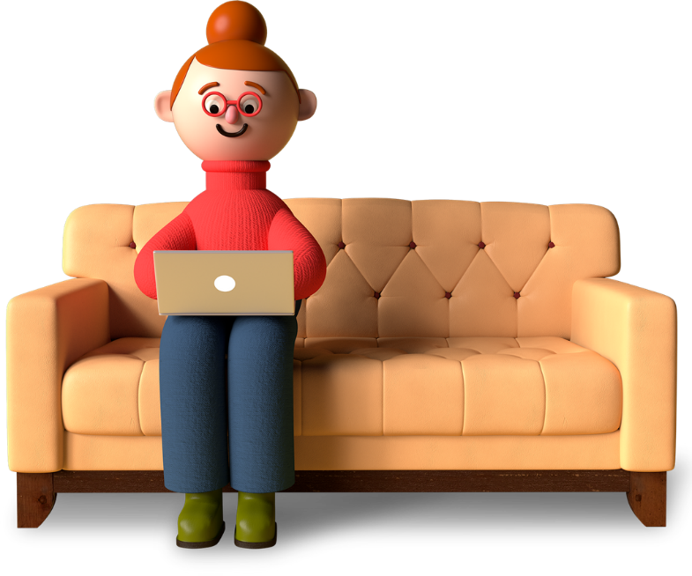
From speaking to teachers, worries fall into three main categories:
01
Practical worries
02
Emotional worries
03
Urban myths

Slide 11
Practical worries such as:
Getting lost at school
Homework
Understanding timetables
Carrying equipment around
Using public transport

Slide 12
Emotional worries such as:
Making new friends
Leaving old friends
Being picked on/bullied
Feeling scared, anxious, nervous about change

Slide 13
Urban myths such as:
Excluded for being late once
Very strict teachers
Lunch money stolen
Head flushed in toilet
Beaten up

Slide 14
We asked primary schools in Hull what their Y6 students were worried about...
Building confidence
Bullying
Conflict resolution (without adult intervention)
Conversation starters
Covid-what might be different?
Different teachers and their expectations
Finding their way (around school)
Friendship changes
Getting involved
Getting organised
Healthy routines
Making sense of school timetables
Managing negative peer pressure
Self-image
Myths/ fake news
Personal safety
Phones and social media in school
Planning and time management
Positive and negative influences
Public transport timetables
Safe travel to school
School rules
School uniform
Secondary school lessons-what's different?
Am I ready for secondary school?

Slide 15
What can you do to help your pupils prepare?

Slide 16
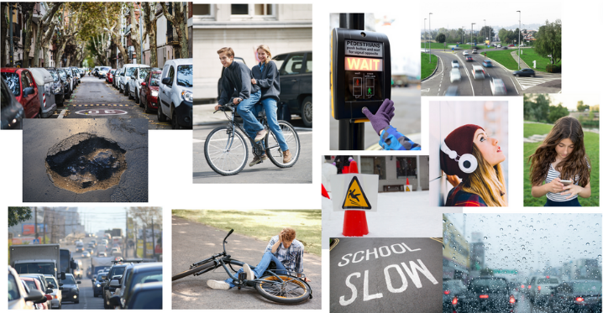
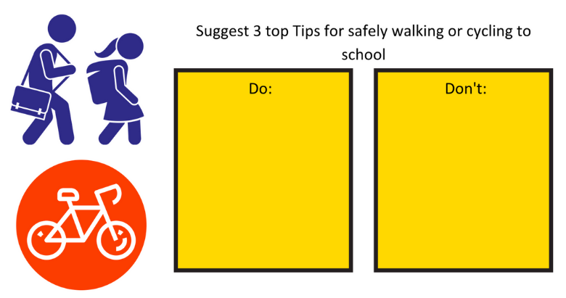
Practical worries: Safe travel to school
Spot the hazards
Top tips for safe travel to school

Slide 17
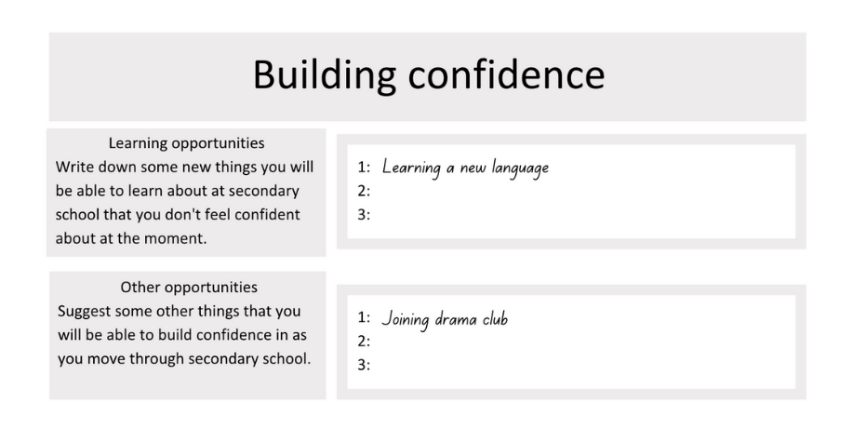
Emotional worries: Building confidence
Building confidence exercise
Tips and reassurance on building confidence

Slide 18
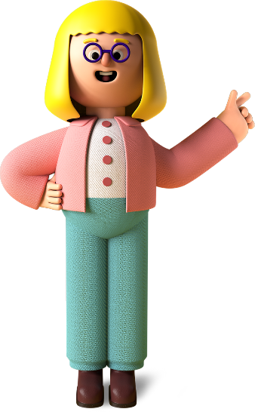
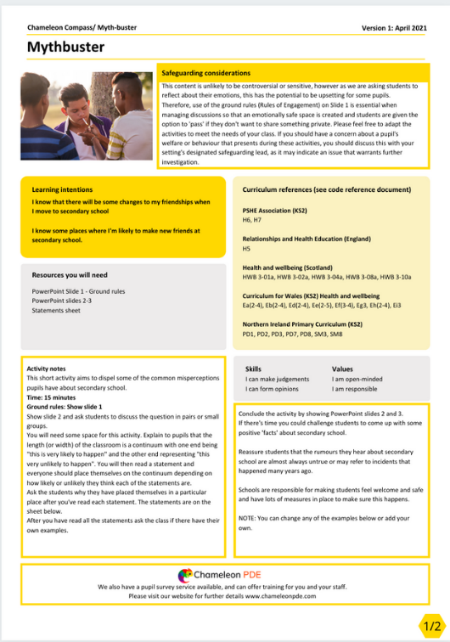
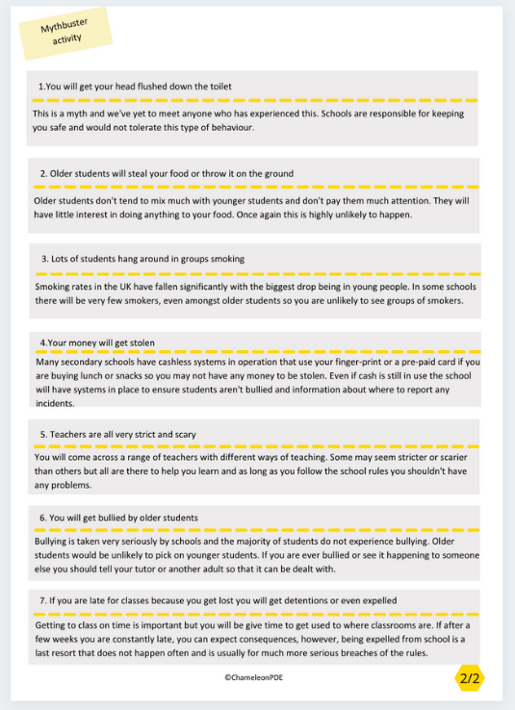
Urban myths: Mythbuster
Dispelling the
myths about secondary school

Slide 19
Do you have a transition programme in place?
What does it include?
Have there been visits to secondary schools?
Were visits effective? Do your students need additional support?

Slide 20
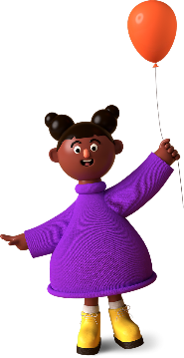
Providing your pupils with the skills to navigate the move from primary to secondary school will boost their confidence and help them look forward to the challenges ahead.

Slide 21
Building your 'gold standard' transition programme
Identify pupil needs
Devise a list of topics/ activities to address needs
Inform parents/carers
Baseline measure
Carry out programme
Repeat baseline and measure effectiveness of interventions

Slide 22
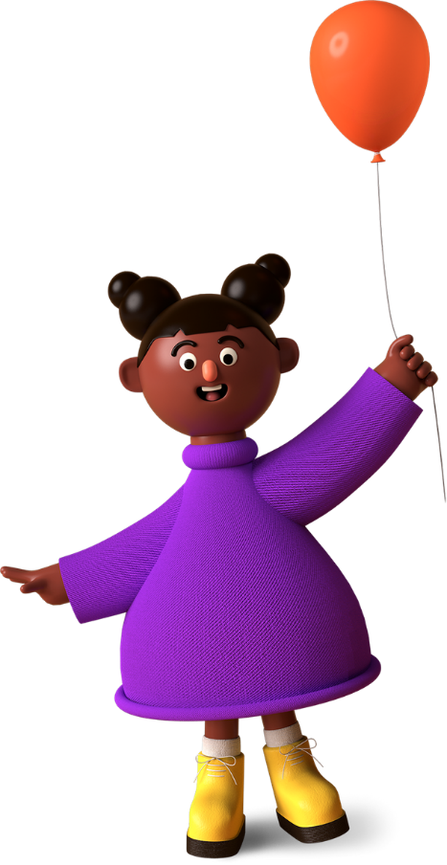
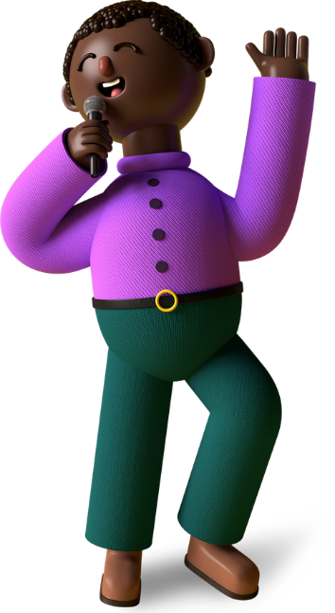
Why do we need to measure effectiveness?
It's easy to assume that pupils' needs have been met by visits to their secondary school- we know that these can sometimes raise anxiety and lead to more questions for pupils.
We also know that some secondary schools do not have a very robust programme in place and we shouldn't assume that pupils are getting what they need to build confidence and reduce anxiety.

Slide 23
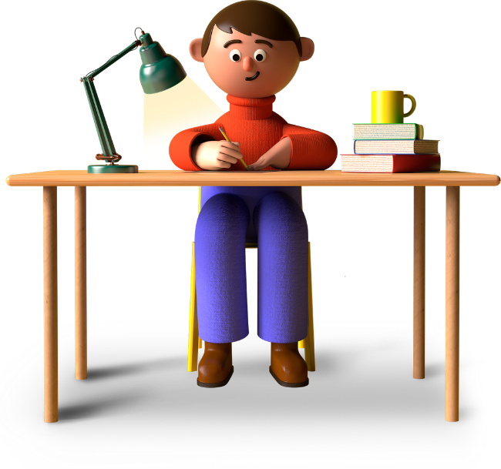
What about COVID?
Currently a bit of an unknown quantity
Children at secondary school have had additional restrictions e.g. wearing masks and regularly carrying out lateral flow tests
Secondary schools will help children manage this if it is necessary

Slide 24
What about parents?
Parents are often worried about transition too, particularly if it is their first child who is making the move.
Parents are likely to be reassured if you share the steps you are taking to prepare their children for secondary school with them and they can continue the discussions at home.

Slide 25
Striking the balance between giving their children more independence but still being there to offer support can also be tricky.
If anything children need more support from parents when they move to secondary school as they are facing so many changes at the same time including puberty.

Slide 26
Any questions?
info@chameleonpde.com

Slide 27
What Chameleon PDE can offer:
Chameleon Compass - transition programme
Library of teacher led activities - we will add to as necessary
Baseline survey to measure confidence before and after
Templates, PowerPoints slides and teacher notes
Editable to meet the needs of your setting & students
£99 plus VAT
www.chameleonpde.com

Slide 28
Thank you for coming!
If you have any further questions or you would like to give us feedback about this webinar please email:
info@chameleonpde.com

