Slide 1
Promotion of child emotional-wellbeing in the school environment & Acting on emerging emotional distress.

Slide 2
Aims of this workshop
Explore the emotional intelligence of the growing child, across the ages
Ideas for teaching and implementing strategies that build resilience - 5 ways
How to recognise signs of emotional distress
Supporting the child's emotional health needs within the teacher role
Other support available within the Gateshead local area

Slide 3
ICE BREAKER

Slide 4
The Emotional Intelligence of the growing child
What is Emotional Intelligence?
Emotional Intelligence is the ability to understand and manage our own emotions and the emotions of others. Its development is distinct from the development of academic intelligence and a child can benefit from the positive impact on success and wellbeing that it can provide.
Psychologist Dr Daniel Goleman (and author of Emotional Intelligence: Why It Can Matter More Than IQ) identified 5 areas that constitute emotional intelligence, and these stay the same for children and adults.
The 5 areas are
Self-awareness: the ability to recognise your own emotions (and how they affect not just yourself but others around you).
Self-regulation: the ability to remain in control of your actions, whatever emotions you may be feeling.
Motivation: the ability to persevere in your pursuits, even in the face of difficulties.
Empathy: the ability to understand and respond to the emotions of others.
Social skills: the ability to use emotional intelligence in the context of interpersonal relationships.

Slide 5
So, What would we class at ‘normal’?
www.gateshead.gov.uk/media/16739/Support-for-primary-schools-with-children-who-have-social-emotional-and-mental-health-needs

Slide 6
Emotional Intelligence Area | Age 4 | Age 5 | Age 6 | Age7
Self-Awareness | Desire for independence. | Begin to recognise how certain things make them feel and start to vocalise this At this age children also develop fears. Usually of animals like dogs and snakes. Girls tend to be more fearful than boys | They understand their own feelings. They understand the consequences of their actions. Children at 6 are able to use words to describe their own feelings | May feel insecure about themselves and may be their own worst critics. Manage emotions better, especially in public situations Starts to use self – calming strategies, such as repeating phrases or taking deep breaths when feeling distressed.
Self-Regulation | Overall gaining better control over emotions. Experiences a broad range of emotions such as jealously, excitement, anger and fear. | Still have tantrums and display emotional extremes | Aware of some of their emotional triggers, such as feeling sad watching a movie Develops improved self-control skills | Better able to handle transitions and last-minute changes. Can usually tolerate going with the flow or unexpected situations.
Motivation | May become more focused on winning when playing games | Want to receive positive responses from adults. | Likes others to know what they have done or achieved – enjoys praise from teachers | Having a specific talent Sharing knowledge with others for gratification
Empathy | Becomes aware of other people’s feelings. | Can show empathy and tend to want to help | Can show empathy and offer to help when they see another in distress. | Understand sophisticated concepts, like not hurting someone’s feelings by saying something critical about them directly to that person
Social Skills | cooperative one minute and overly demanding the next. | Want to please and make friends Separates from caregivers without excessive upset Plays and shares with other children | Children show jealousy towards others They enjoy playing alone. Friendships and social relationships with peers and adults become more complex and take on more of the world around them and their role in it. | Power struggles in friendship groups Lots of fall outs and making up Sometimes feeling left out or lonely at school

Slide 7
Emotional Intelligence Area | Age 8 | Age 9 | Age 10 | Age11
Self-Awareness | May show more sophisticated and complex emotions and interactions and develop a more sophisticated sense of themselves in the world. Their interests, talents, friends and relationships with family members help them establish a clear self identity. Begin to desire privacy. | Becoming more aware of real world danger and disasters. Fears about events such as crime or storms or anxieties about a parent dying one day may replace fears they may have had as a younger child such as fear of a monster. They may insist on having their own way but are able to listen to reason. l May act unreasonable or rude when things don’t go as planned, but are as able to recognise behaviour and apologise. | Developing a better sense of who they are in the world. Emotionally starting to prepare for their transition to “big” school transition into adolescence can trigger a host of emotions; excitement, uncertainty, trepidation and even embarrassment. May see some volatility in their emotions. | Becomes more aware of or questions sexuality Starts to resist physical affection from parents Previous positive self-esteem may be challenged at this age Embarrassment and awkwardness may cause emerging anxiety
Self-Regulation | Becomes more balanced in coping with frustration, failure and disappointment | may also be moody and may be upset one minute and then fine the next Seeks out peers to cope with uncomfortable emotions but are able to rely on own resources | Stress will play a huge role in mood swings May become emotional very easily and struggle to calm down | Experiences mood swings regularly – struggles to accept that their mood is low/negative
Motivation | Enjoys being given responsibility but can push boundaries | strong desire to belong to a group and establish their place within the social order at school. As a result, many will become vulnerable to peer pressure because they want to impress their peer group | Admires and imitates older children | Focussing on school transition and physical transition from child to adolescence
Empathy | Most are able to mask their true thoughts or emotions to spare someone’s feelings. | Can put herself in someone else’s shoes and imagine how someone might feel. Can imagine what kind of action or response might help a person feel better. | Understands that she is a distinct person from those around her and that other people may have different feelings and perspective than her own. | May push boundaries and intentionally cause upset
Social Skills | Seek direct physical contact from caregivers when under stress but may resist physical contact at other times | Better able to handle conflict. to seek relationships independent of their family, including sleep overs at friends’ houses. | Begins to question Authority More skilled at handling conflict and negotiating solutions with friends. | Forms strong bonds with same sex friends often lose interest in family matters. When at home, they may want to be alone, hanging out in their rooms. Can be embarrassed easily - may sulk with teachers more

Slide 8
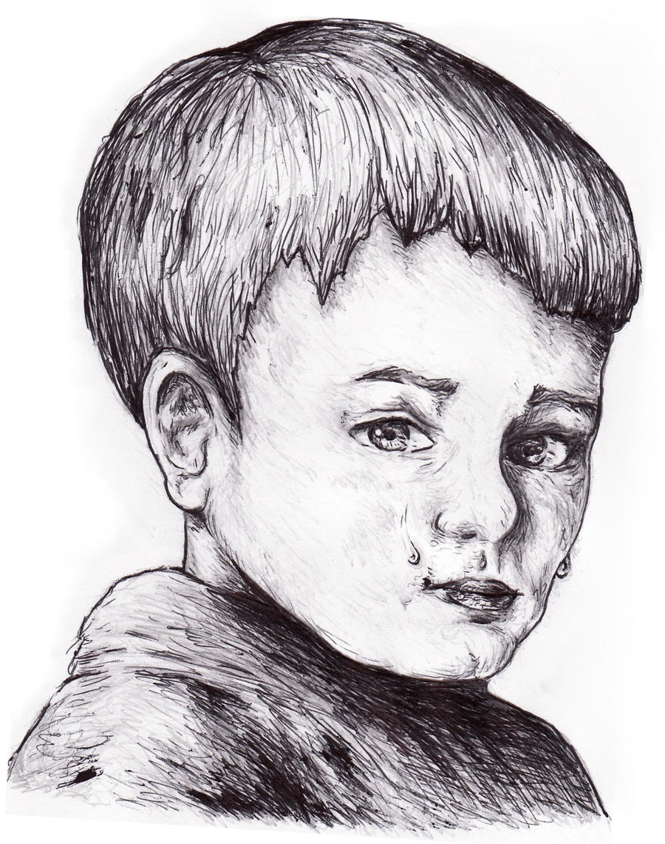
Factors effecting the emotional intelligence of children
The following can all have an impact:
• premature / low birth weight
• poor health
• Parental Mental Ill Health
• Poverty
• lack of warmth and affection
• parental drug or substance abuse
• poor housing
• abuse
• social, racial or cultural discrimination
• poor relationships with adults
• Poor School attendance
Research indicates that securely-attached children develop more connections and have well-developed brains. However, no one person can provide everything a growing child needs and children can form close attachments with several people.

Slide 9
Teaching and implementing strategies that build resilience - 5 ways

Slide 10
Resilience CAN be built

Slide 11
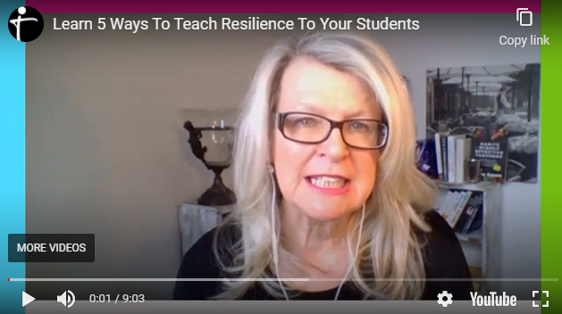
5 Ways to teach resilience
The highly effective teacher
https://youtu.be/Bb4whqVawdo

Slide 12
1. Build positive relationships
A positive relationship with one caring adult can change the trajectory for even the most at risk student (Anderson, et al, 2004).
People don’t care how much you know until they know how much you care
Ways to build positive relationships with students
Learn your students’ names.
Greet students at the door.
Chat with students as they arrive to class.
Share some of your life with students.
Give positive reinforcement that shows you know them.
Go to a sports game on the weekend or after school.
Allow time in class for students to share things about their interests.
Use Circle Time to give all students a chance to speak about what is important to them.
Aim to speak to every student every day.
Ask students to answer questions you know they know.
Allow processing time when asking a question.
Display your confidence in students to do well.
Check in with students who are struggling emotionally or academically.

Slide 13
FOUR:
2. Teach Social Emotional Skills
Improve peer relationships by explicitly teaching skills of self-awareness, self-management, social awareness, relationship skills and responsible decision-making.
Ways To Include Social And Emotional Learning In Your Classroom
Use cooperative learning strategies to help students learn to get along with each other, work together toward a common goal and respect others’ opinions.
Give students responsibility for their classroom environment, such as preparing for an activity.
Play games that teach social and emotional skills like sharing, taking turns, being a good loser/winner, how to manage disappointment and how to be a good teammate.
Conduct class meetings where students air their concerns and work to develop solutions to class problems.
Provide choice in academic tasks so they learn how to make decisions and understand the consequences of their decisions.
Include students in decision making about the running of the class. Discuss issues such as keeping the classroom tidy, how to make the classroom operate more smoothly, get feedback from students about how they enjoy your lessons and how effective they are.
Reinforce students by giving them specific feedback about social and emotional skills they are using effectively.
When discussing stories and biographies refer to the characters’ behaviour in relation to social and emotional skills.

Slide 14
FOUR:
3. Foster Positive Emotions
School connectedness is a strong protective factor for health and academic outcomes for all students (Wingspread Declaration on School Connectedness, 2001; Roffey, 2012).
Ways To Encourage Positive Emotional Growth In Your Student
Teach Your Student About Complex Emotions
Let Them Know Everyone Feels Different Emotions
Don’t Be Afraid To Show Your Emotions Too
Provide A Safe Environment
Let Them Express Their Feelings In A Healthy Way
Tell Them It’s Okay Not To Always Be Happy
Don’t Just Brush Off Their Emotions

Slide 15
FOUR:
4. Identify Student Strengths
A strengths based approach that identifies student abilities and positive qualities then works proactively to build upon these strengths, gives your students more opportunities to be successful and build a strong sense of self-worth.
5 Steps for Recognising and Promoting Strengths in Kids
Consider different types of strengths.
Follow your students interests.
Help the student identify strengths.
Talk about strengths often.
Take note of the child’s strengths and successes.

Slide 16
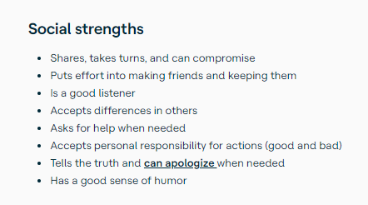
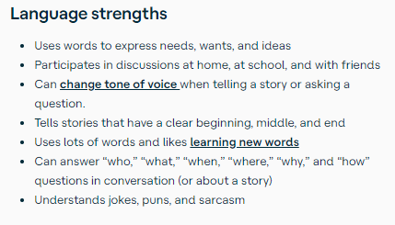
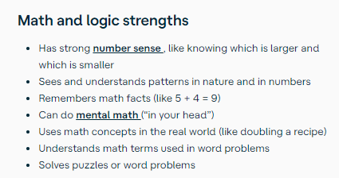
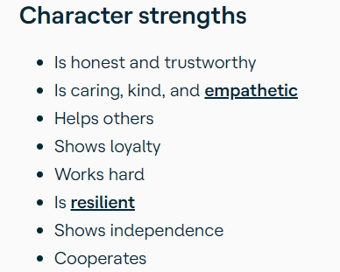
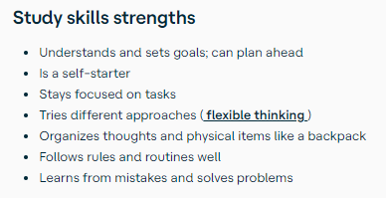
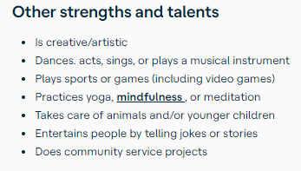
Strengths Checklist

Slide 17
FOUR:
5. Build A Sense Of Meaning And Purpose
Working towards worthwhile goals increases students sense of wellbeing which impacts positively on student achievement.
1. Peer teaching.
2. Promote voting and scoring. Encouraging explanations.
3. Pupil class roles.
4. To do lists.
5. Team Teach between staff
6. Do Relaxation Now.

Slide 18
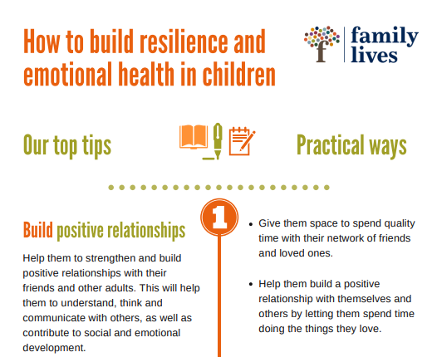
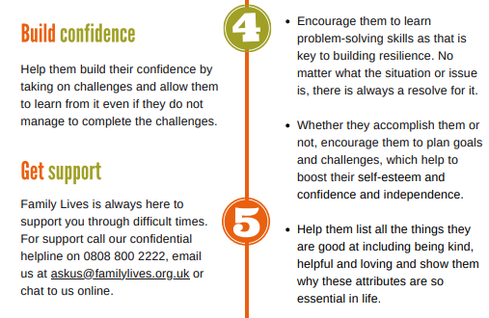
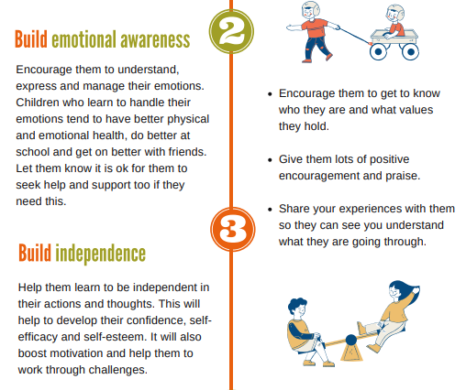

Slide 19
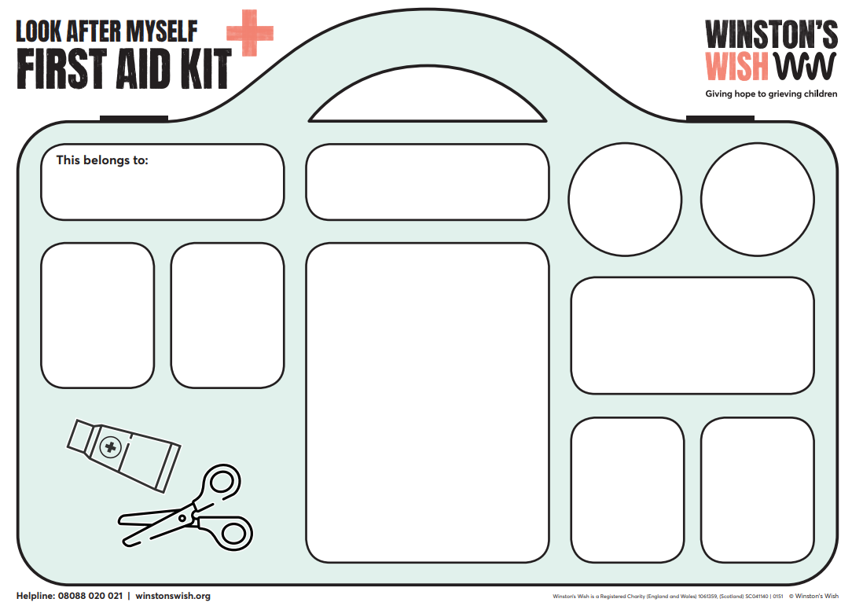
www.winstonswish.org/wp-content/uploads/2020/05/Winstons-Wish-First-Aid-Kit.pdf

Slide 20
The Sunflower Analogy

Slide 21
What things nurture your emotional wellbeing?
What kind of things do you need to feel emotionally positive?
What makes you feel grounded or rooted or safe?
Place, person, something else?
Personal Exercise
Who is in your social network to support you in times when you need it, who can you rely on?
When do you feel you have been resilient in tough time? Flexible, able to bend?
What activities are healthy wellbeing for you?
Connecting with people – Emotional Resilience 2021

Slide 22
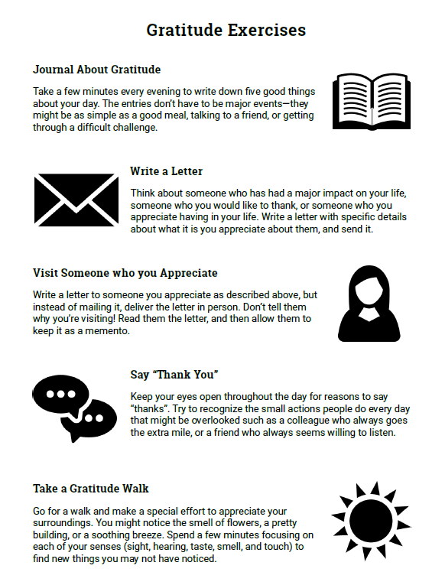

Slide 23
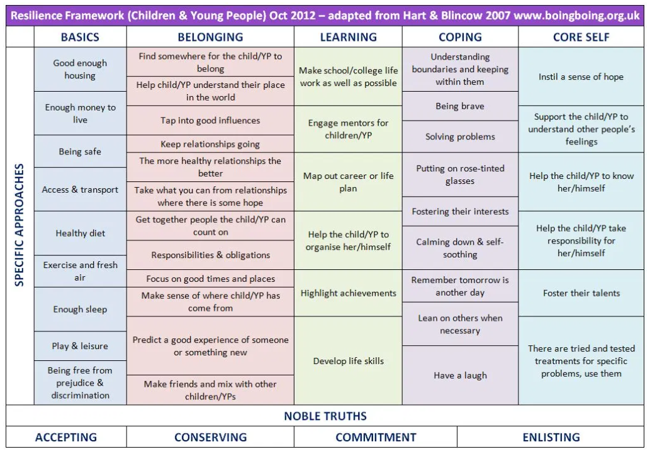
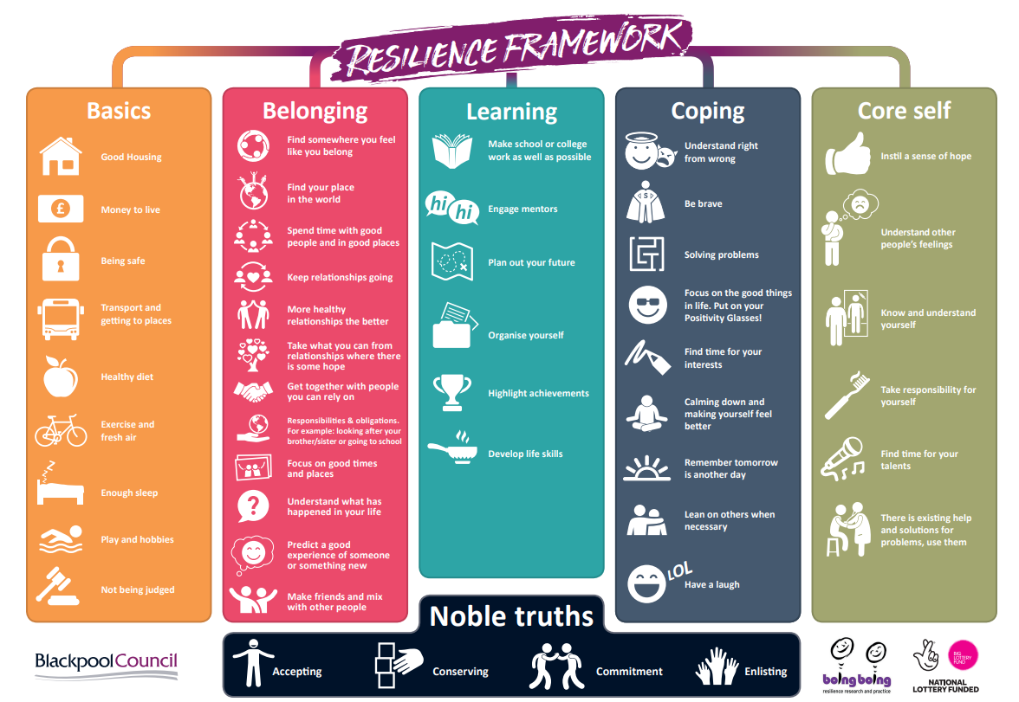
Resilience Framework designed by Marton Primary School in Blackpool during Blackpool’s Town Wide ‘Resilience Revolution’
www.youngminds.org.uk/media/1486/interactive_resilience_framework-002.pdf
www.boingboing.org.uk/resilience/resilient-therapy-resilience-framework/

Slide 24
How to recognise signs of emotional distress
The NSPCC tells us that
Common warning signs of mental health issues include:
sudden mood and behaviour changes
self-harming
unexplained physical changes, such as weight loss or gain
sudden poor academic behaviour or performance
sleeping problems
changes in social habits, such as withdrawal or avoidance of friends and family.
What other signs might we notice?

Slide 25
The Leuven Scale for Wellbeing

Slide 26
The Leuven Scale for Wellbeing
Level | Wellbeing | Signals
1 | Extremely Low | The child clearly shows signs of discomfort such as crying or screaming. They may look dejected, sad, frightened or angry. The child does not respond to the environment, avoids contact and is withdrawn.
2 | Low | The posture, facial expression and actions indicate that the child does not feel at ease. However, the signals are less explicit than under level 1 or the sense of discomfort is not expressed the whole time.
3 | Moderate | The child has a neutral posture. Facial expression and posture show little or no emotion. There are no signs indicating sadness or pleasure, comfort or discomfort.
4 | High | The child shows obvious signs of satisfaction (as listed under level 5). However, these signals are not constantly present with the same intensity.
5 | Extremely High | The child looks happy and cheerful, smiles, cries out with pleasure. They may be lively and full of energy. Actions can be spontaneous and expressive. The child may talk to him/herself, play with sounds, hum, sing. The child appears relaxed and does not show any signs of stress or tension. He / she is open and accessible to the environment. The child expresses self-confidence and self-assurance.

Slide 27
The Leuven Scale for Involvement
Level | Involvement | Signals
1 | Extremely Low | Activity is simple, repetitive and passive. The child seems absent and displays no energy. They may stare into space or look around to see what others are doing.
2 | Low | Frequently interrupted activity. The child will be engaged in the activity for some of the time they are observed, but there will be moments of non-activity when they will stare into space, or be distracted by what is going on around.
3 | Moderate | Mainly continuous activity. The child is busy with the activity but at a fairly routine level and there are few signs of real involvement. They make some progress with what they are doing but don’t show much energy and concentration and can be easily distracted.
4 | High | Continuous activity with intense moments. The child’s activity has intense moments and at all times they seem involved. They are not easily distracted.
5 | Extremely High | The child shows continuous and intense activity revealing the greatest involvement. They are concentrated, creative, energetic and persistent throughout nearly all the observed period.

Slide 28
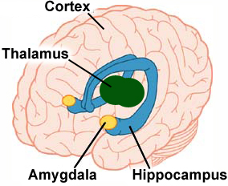
Deep within our brain is the amygdala. We need this small, almond-shaped set of neurons to help us process emotions. Essentially, the amygdala responds to any potential threat. It ‘remembers’ unpleasant or fearful triggers and activates the release of chemicals that make us experience the ‘fight or flight’ sensations, such as increased heart rate, or an urge to run.
The amygdala works at lightning speed! This ‘emotive’ part of our brain responds a hundred times faster than our thinking brain. As a result, whenever we feel frightened or angry we lose our capacity to think clearly because the amygdala halts all thought. An example is–
when someone makes us jump by leaping out at us in the dark, the amygdala ‘remembers’ the danger of footsteps and releases stress chemicals, which increase the heart rate.
Whenever we here fast footsteps coming behind us our stress levels when increase.
Children who experience stress and anxiety early on in life are more at risk of developing depression and other anxiety disorders when they are adults. The size of their amygdala actually grows when there is an excess of anxiety and stress (Cohen et al, 2013).

Slide 29
Supporting the child's emotional health needs within the teacher role
Talking with a child about their mental health
Doing OK – Struggling – Unwell – In Crisis
Using scaling techniques
What if a child doesn't want to talk to me?
Implement Wellbeing Plan
Safeguarding and child protection issues
Confidentiality

Slide 30
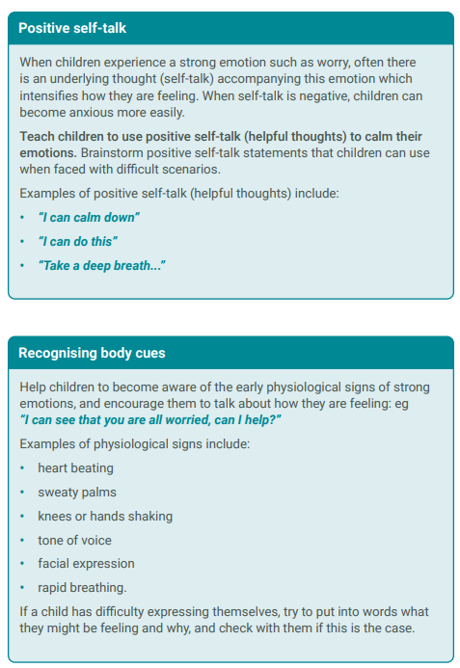
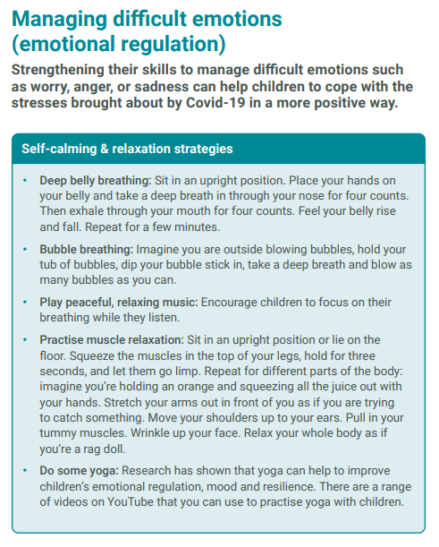
Mentally Healthy Schools 2020

Slide 31
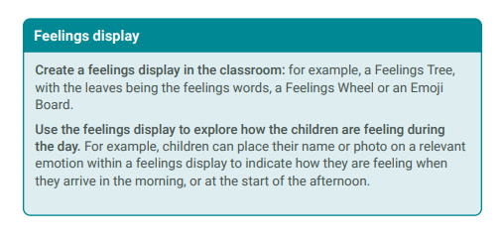
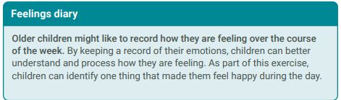
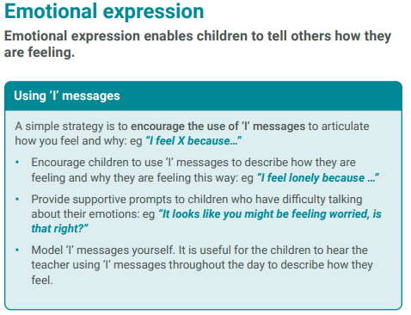
Mentally Healthy Schools 2020

Slide 32
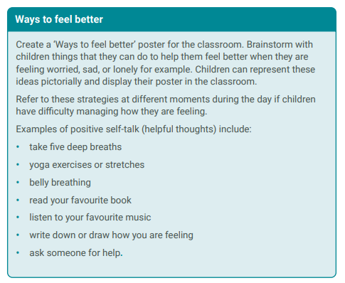
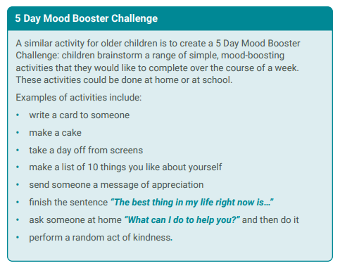
Mentally Healthy Schools 2020

Slide 33
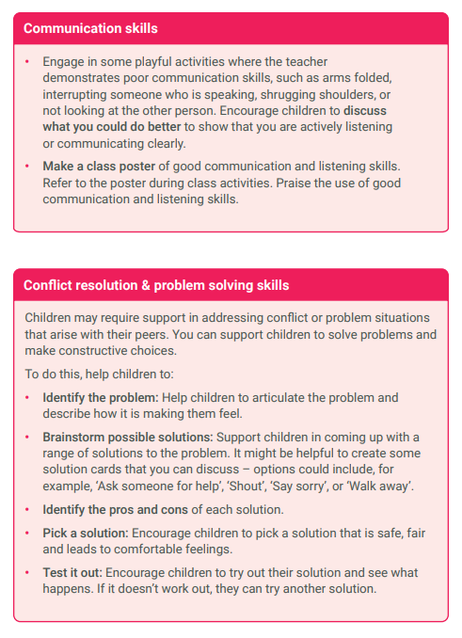
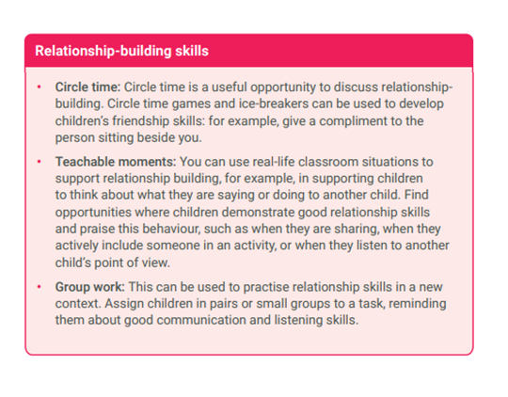
Mentally Healthy Schools 2020

Slide 34
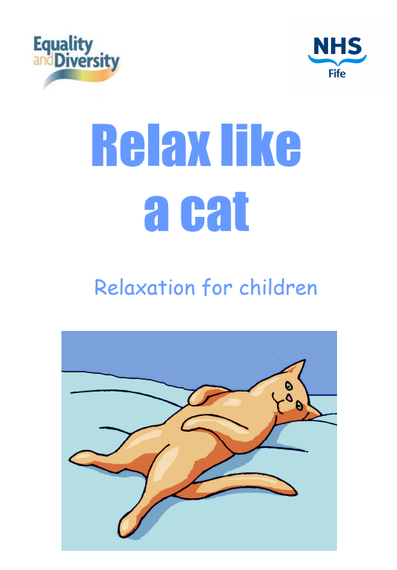

Slide 35
Parent
Transition Events

Slide 36
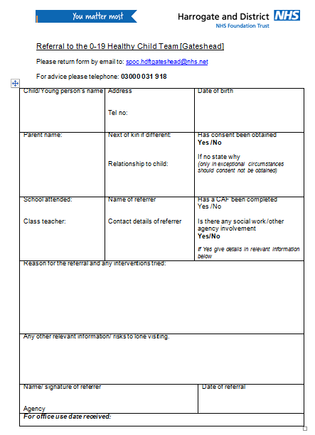
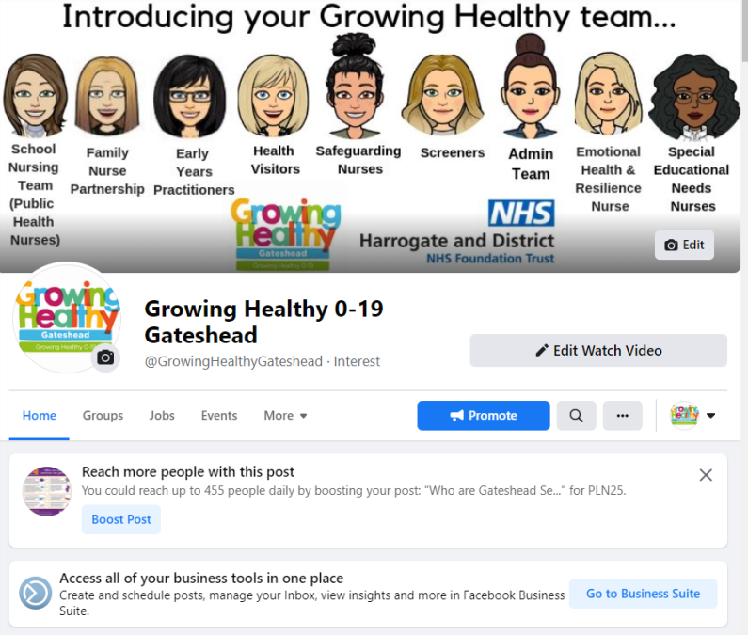
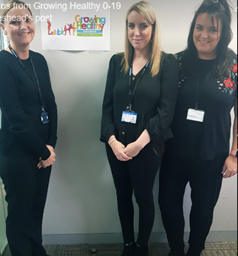
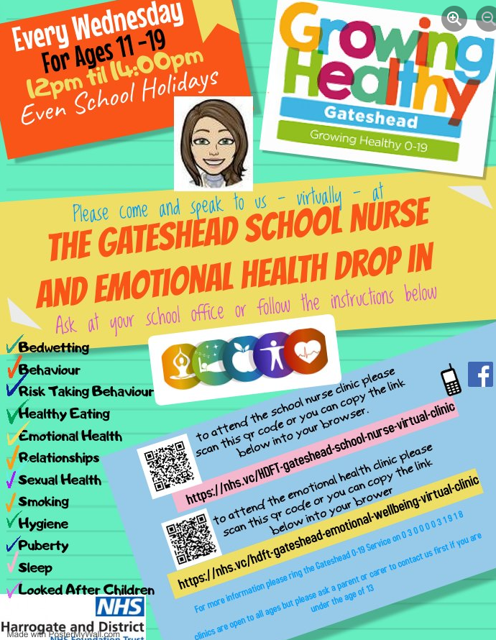
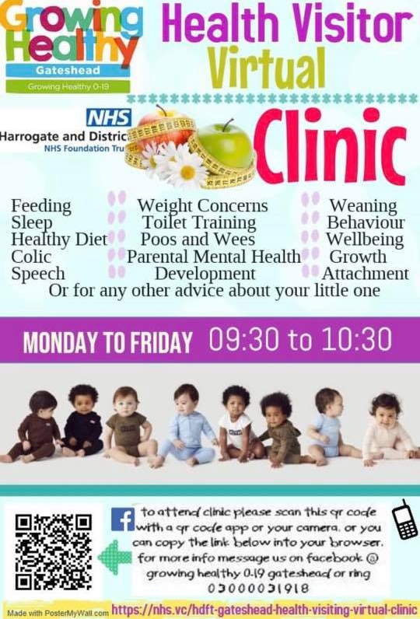

Slide 37
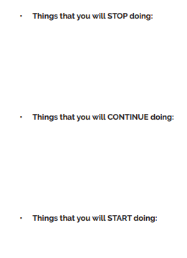

Slide 39
Email spoc.hdftgateshead@nhs.net
Call 0 3 0 0 0 0 3 1 9 1 8
Facebook – Growing Healthy 0-19 Gateshead

